Slide 1
AZ-900T0x Module 05: Identity, governance, privacy, and compliance
Notes:
Adjust the cover for either AZ-900T00 or AZ-900T01.
This content in SkillPipe is now aligned with the content in Learn. The notes section of the PPT will call out any free Learn sandbox exercises available and provide direct links that can be shared with students (if they are not able to create a free Azure account and/or are not following along in Learn).
https://docs.microsoft.com/en-us/learn/paths/az-900-describe-identity-governance-privacy-compliance-features/

Slide 2

Module outline
Notes:
Learn and SkillPipe content order note:
Slides 1-5
https://docs.microsoft.com/en-us/learn/modules/secure-access-azure-identity-services/1-introduction

Slide 3
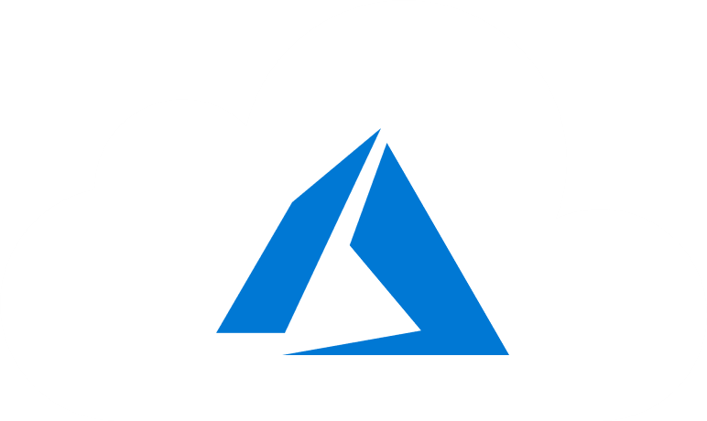
Module 05 – Outline
You will learn the following concepts:
Azure identity services
Authentication versus Authorization
Azure AD, MFA, SSO and Conditional Access
Azure governance features
RBAC
Resource locks and tags
Policy, Blueprints, and CAF
Azure privacy and compliance
Privacy statement and Online Services Terms
Trust Center and compliance documentation
Azure Sovereign Regions
Notes:
Learn and SkillPipe content order note:
Slides 1-5
https://docs.microsoft.com/en-us/learn/modules/secure-access-azure-identity-services/1-introduction

Slide 4

Core Azure identity services
Notes:
Learn and SkillPipe content order note:
Slides 1-5
https://docs.microsoft.com/en-us/learn/modules/secure-access-azure-identity-services/1-introduction

Slide 5
Azure Identity Services - Objective Domain
Explain the difference between authentication and authorization
Define Azure Active Directory
Describe the functionality and usage of Azure Active Directory
Describe the functionality and usage of Conditional Access, Multi-Factor Authentication (MFA), and Single Sign-On (SSO)
Notes:
Learn and SkillPipe content order note:
Slides 1-5
https://docs.microsoft.com/en-us/learn/modules/secure-access-azure-identity-services/1-introduction

Slide 6



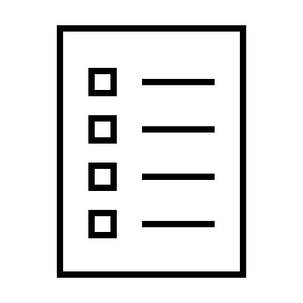





Compare Authentication and Authorization
Authentication
Identifies the person or service seeking access to a resource.
Requests legitimate access credentials.
Basis for creating secure identity and access control principles.
Authorization
Determines an authenticated person’s or service’s level of access.
Defines which data they can access, and what they can do with it.
Notes:
✔️Authentication is sometimes shortened to AuthN, and authorization is sometimes shortened to AuthZ.
Authentication
Identifies the person or service seeking access to a resource.
Requests legitimate access credentials.
Basis for creating secure identity and access control principles.
Authorization
Determines an authenticated person’s or service’s level of access.
Defines which data they can access, and what they can do with it.
Learn and SkillPipe content order note:
https://docs.microsoft.com/en-us/learn/modules/secure-access-azure-identity-services/2-compare-authentication-authorization

Slide 7
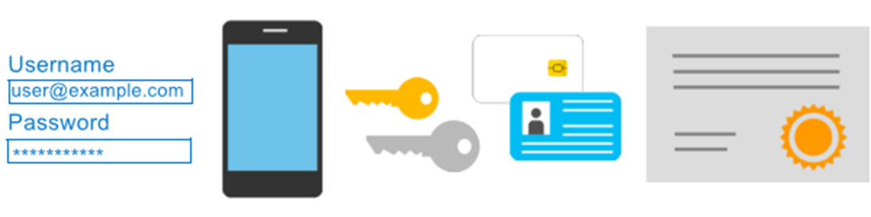
Azure Multi-Factor Authentication
Provides additional security for your identities by requiring two or more elements for full authentication.
Something you know ←→ Something you possess ←→ Something you are
Notes:
Discuss what could qualify for each of the items listed
Something you know: This could be a password or the answer to a security question.
Something you possess: This might be a mobile app that receives a notification, or a token-generating device.
Something you are: This is typically some sort of biometric property, such as a fingerprint or face scan used on many mobile devices.
MFA - https://docs.microsoft.com/en-us/azure/active-directory/authentication/concept-mfa-howitworks
Learn and SkillPipe content order note:
Slides 7 & 9
https://docs.microsoft.com/en-us/learn/modules/secure-access-azure-identity-services/2-compare-authentication-authorization

Slide 8

Azure Active Directory (AAD)
Azure Active Directory (AAD) is Microsoft Azure’s cloud-based identity and access management service.
Authentication (employees sign-in to access resources).
Single sign-on (SSO).
Application management.
Business to Business (B2B).
Business to Customer (B2C) identity services.
Device management.
Notes:
Azure AD - https://azure.microsoft.com/en-us/services/active-directory/
Azure tenant
A dedicated and trusted instance of Azure AD that's automatically created when your organization signs up for a Microsoft cloud service subscription, such as Microsoft Azure, Microsoft Intune, or Office 365. An Azure tenant represents a single organization.
Azure AD directory
Each Azure tenant has a dedicated and trusted Azure AD directory. The Azure AD directory includes the tenant's users, groups, and apps and is used to perform identity and access management functions for tenant resources.
Learn and SkillPipe content order note:
https://docs.microsoft.com/en-us/learn/modules/secure-access-azure-identity-services/3-what-is-azure-active-directory

Slide 9
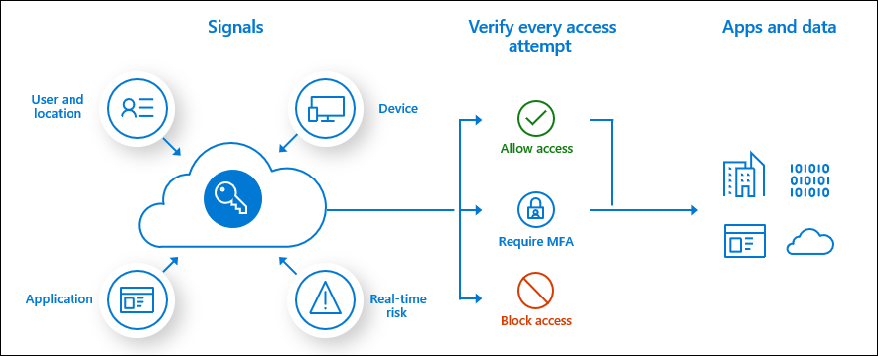
Conditional Access
Conditional Access is used by Azure Active Directory to bring signals together, to make decisions, and enforce organizational policies.
User or Group Membership
IP Location
Device
Application
Risk Detection
Notes:
https://docs.microsoft.com/en-us/azure/active-directory/conditional-access/overview
The modern security perimeter now extends beyond an organization's network to include user and device identity. Organizations can utilize these identity signals as part of their access control decisions.
Conditional Access is the tool used by Azure Active Directory to bring signals together, to make decisions, and enforce organizational policies. Conditional Access is at the heart of the new identity driven control plane.
Conditional Access policies at their simplest are if-then statements, if a user wants to access a resource, then they must complete an action. Example: A payroll manager wants to access the payroll application and is required to perform multi-factor authentication to access it.
Administrators are faced with two primary goals:
Empower users to be productive wherever and whenever
Protect the organization's assets
By using Conditional Access policies, you can apply the right access controls when needed to keep your organization secure and stay out of your user's way when not needed.
Learn and SkillPipe content order note:
Slides 7 & 9
https://docs.microsoft.com/en-us/learn/modules/secure-access-azure-identity-services/2-compare-authentication-authorization

Slide 10
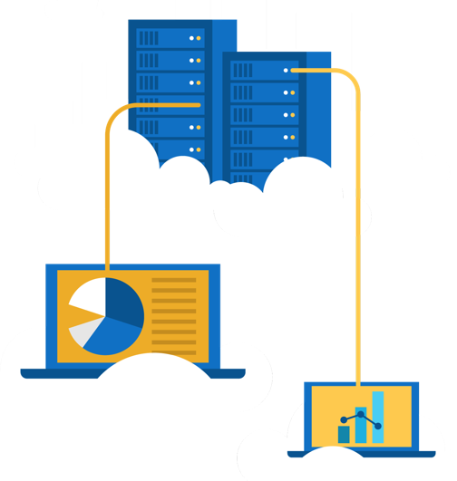
Walkthrough - Manage access with RBAC
Assign roles and view activity logs.
View and assign roles.
View the activity log and remove a role assignment.

Slide 11
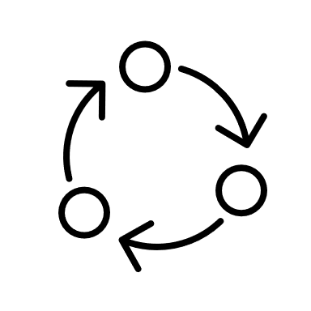
Azure Governance Methodologies
Notes:
Learn and SkillPipe content order note:
Slides 11-12
https://docs.microsoft.com/en-us/learn/modules/build-cloud-governance-strategy-azure/1-introduction

Slide 12
Azure Governance Methodologies - Objective Domain
Describe the functionality and the usage of:
Role-Based Access Control (RBAC)
Resource locks
Tags
Azure Policy
Azure Blueprints
Cloud Adoption Framework for Azure
Notes:
Learn and SkillPipe content order note:
Slides 11-12
https://docs.microsoft.com/en-us/learn/modules/build-cloud-governance-strategy-azure/1-introduction

Slide 13






Explore Role-based access control (RBAC)
Fine-grained access management.
Segregate duties within the team and grant only the amount of access to users that they need to perform their jobs.
Enables access to the Azure portal and controlling access to resources.
Azure
Active Directory
Azure
subscription
User
Apps
User groups
Resource group
Resource group
Notes:
Azure RBAC - https://docs.microsoft.com/en-us/azure/role-based-access-control/overview
Learn and SkillPipe content order note:
https://docs.microsoft.com/en-us/learn/modules/build-cloud-governance-strategy-azure/4-control-access-azure-rbac

Slide 14
Resource locks
Protect your Azure resources from accidental deletion or modification.
Manage locks at subscription, resource group, or individual resource levels within Azure Portal.
Lock Types | Read | Update | Delete
CanNotDelete | Yes | Yes | No
ReadOnly | Yes | No | No
Notes:
Resource Locks - https://docs.microsoft.com/en-us/azure/azure-resource-manager/resource-group-lock-resources
Learn and SkillPipe content order note:
https://docs.microsoft.com/en-us/learn/modules/build-cloud-governance-strategy-azure/5-prevent-changes-resource-locks

Slide 15
Walkthrough - Manage Resource Locks
Create a resource group add a lock and test deletion, test deleting a resource in the resource group.
Create a resource group.
Add a resource lock to prevent deletion of a resource group.
Test deleting a member of the resource group.
Remove the resource lock.
Notes:
Learn has a sandbox exercise - Exercise - Protect a storage account from accidental deletion by using a resource lock
https://docs.microsoft.com/en-us/learn/modules/build-cloud-governance-strategy-azure/6-protect-storage-account-resource-lock

Slide 16
Tags
Provides metadata for your Azure resources.
Logically organizes resources into a taxonomy.
Consists of a name-value pair.
Very useful for rolling up billing information.
OR
owner: joe
department: marketing
environment: production
cost-center: marketing
Notes:
Tags - https://docs.microsoft.com/en-us/azure/azure-resource-manager/resource-group-using-tags
Learn and SkillPipe content order note:
https://docs.microsoft.com/en-us/learn/modules/build-cloud-governance-strategy-azure/7-organize-resource-tags

Slide 17
Walkthrough – Implement resource tagging
Create a policy assignment that requires tagging, then create a storage account and test the tagging.
Create a policy assignment to require tagging.
Create a storage account to test required tagging.
View all resources with a specific tag.
Delete the policy assignment.

Slide 18

Azure Policy
Azure Policy helps to enforce organizational standards and to assess compliance at-scale. Provides governance and resource consistency with regulatory compliance, security, cost, and management.
Evaluates and identifies Azure resources that do not comply with your policies.
Provides built-in policy and initiative definitions, under categories such as Storage, Networking, Compute, Security Center, and Monitoring.
Notes:
Azure Policy - https://azure.microsoft.com/en-us/services/azure-policy
Stay compliant with your corporate standards and service level agreements (SLAs) by using policy definitions to enforce rules and effects for your Azure resources.
Evaluates and identifies Azure resources that do not comply with your policies.
Provides built-in policy and initiative definitions, under categories such as Storage, Networking, Compute, Security Center, and Monitoring.
Learn content notes:
https://docs.microsoft.com/en-us/learn/modules/build-cloud-governance-strategy-azure/8-control-audit-resources-azure-policy

Slide 19
Walkthrough - Create an Azure Policy
Create an Azure Policy to restrict deployment of Azure resources to a specific location.
Create a policy assignment.
Test the allowed location policy.
Delete the policy assignment.
Notes:
Learn has a sandbox exercise - Exercise - Restrict deployments to a specific location by using Azure Policy
https://docs.microsoft.com/en-us/learn/modules/build-cloud-governance-strategy-azure/9-restrict-location-azure-policy

Slide 20

Azure Blueprints
Azure Blueprints makes it possible for development teams to rapidly build and stand up new environments. Development teams can quickly build trust through organizational compliance with a set of built-in components (such as networking) in order to speed up development and delivery.
Role Assignments
Policy Assignments
Azure Resource Manager Templates
Resource Groups
Notes:
Azure Blueprints - https://azure.microsoft.com/en-us/services/blueprints/
Learn and SkillPipe content order note:
https://docs.microsoft.com/en-us/learn/modules/build-cloud-governance-strategy-azure/10-govern-subscriptions-azure-blueprints

Slide 21
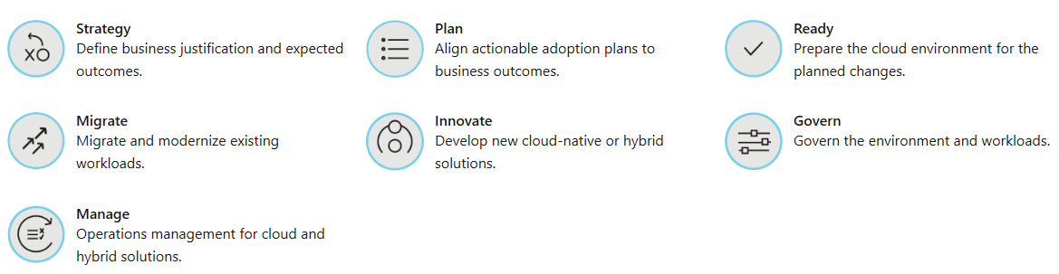
Cloud Adoption Framework
The One Microsoft approach to cloud adoption in Azure.
Best practices from Microsoft employees, partners, and customers.
Tools, guidance, and narratives for strategies and outcomes.
Notes:
Learn and SkillPipe content order note:
https://docs.microsoft.com/en-us/learn/modules/build-cloud-governance-strategy-azure/2-accelerate-cloud-adoption-framework

Slide 22

Privacy, compliance, and data protection standards
Notes:
Learn and SkillPipe content order note:
Slides 22-24
https://docs.microsoft.com/en-us/learn/modules/examine-privacy-compliance-data-protection-standards/1-introduction

Slide 23
Privacy, Compliance, and Data Protection - Objective Domain
Describe the purpose of the:
Microsoft core tenants of Security, Privacy, and Compliance
Microsoft Privacy Statement, Online Services Terms (OST) and Data Protection Amendment (DPA)
Trust Center
Azure compliance documentation
Azure Sovereign Regions (Azure Government cloud services and Azure China cloud services)
Notes:
Learn and SkillPipe content order note:
Slides 22-24
https://docs.microsoft.com/en-us/learn/modules/examine-privacy-compliance-data-protection-standards/1-introduction

Slide 24

Security, Privacy, and Compliance
Security: Secure by design. With built in intelligent security, Microsoft helps to protect against known and unknown cyberthreats, using automation and artificial intelligence.
Privacy: We are committed to ensuring the privacy of organizations through our contractual agreements, and by providing user control and transparency.
Compliance: We respect local laws and regulations and provide comprehensive coverage of compliance offerings.
Notes:
Learn and SkillPipe content order note:
Slides 22-24
https://docs.microsoft.com/en-us/learn/modules/examine-privacy-compliance-data-protection-standards/1-introduction

Slide 25
Compliance Terms and Requirements
Microsoft provides the most comprehensive set of compliance offerings (including certifications and attestations) of any cloud service provider. Some compliance offerings include.
CJIS Criminal Justice Information Services | HIPAA Health Insurance Portability and Accountability Act
CSA STAR Certification | ISO/IEC 27018
EU Model Clauses | NIST National Institute of Standards and Technology
Notes:
Should discuss the questions below with students. When selecting a cloud provider to host your solutions, you should understand how that provider can help you comply with regulations and standards. Some questions to ask about a potential provider include:
How compliant is the cloud provider when it comes to handling sensitive data?
How compliant are the services offered by the cloud provider?
How can I deploy my own cloud-based solutions to scenarios that have accreditation or compliance requirements?
You can view all the Microsoft compliance offerings at Microsoft Compliance Center - Compliance Offerings
Learn and SkillPipe content order note:
https://docs.microsoft.com/en-us/learn/modules/examine-privacy-compliance-data-protection-standards/2-explore-compliance-terms-requirements

Slide 26

Microsoft privacy statement
The Microsoft privacy statement provides openness and honesty about how Microsoft handles the user data collected from its products and services.
The Microsoft privacy statement explains:
What data Microsoft processes.
How Microsoft processes it.
What purposes the data is used for.
Notes:
Microsoft's Privacy Statement at - microsoft.com/privacystatement
Learn and SkillPipe content order note:
Slides 26-67
https://docs.microsoft.com/en-us/learn/modules/examine-privacy-compliance-data-protection-standards/3-access-microsoft-privacy-statement

Slide 27
Online Services Terms and Data Protection Addendum
Online Services Terms: The licensing terms define the terms and conditions for the products and Online Services you purchase through Microsoft Volume Licensing programs.
Data Protection Addendum: The DPA sets forth the obligations, with respect to the processing and security of Customer Data and Personal Data, in connection with the Online Services.
Notes:
Online Services Term - https://www.microsoft.com/en-us/licensing/product-licensing/products
Data Protection Addendum -- https://www.microsoftvolumelicensing.com/DocumentSearch.aspx?Mode=3&DocumentTypeId=67
Learn and SkillPipe content order note:
Slides 26-67
https://docs.microsoft.com/en-us/learn/modules/examine-privacy-compliance-data-protection-standards/3-access-microsoft-privacy-statement

Slide 28

Trust Center
Learn about security, privacy, compliance, policies, features, and practices across Microsoft’s cloud products.
The Trust Center website provides:
In-depth, expert information.
Curated lists of recommended resources, arranged by topic.
Role-specific information for business managers, administrators, engineers, risk assessors, privacy officers, and legal teams.
Notes:
Trust Center - https://www.microsoft.com/trustcenter
Learn and SkillPipe content order note:
https://docs.microsoft.com/en-us/learn/modules/examine-privacy-compliance-data-protection-standards/4-explore-trust-center

Slide 29
Walkthrough – Exploring the Trust Center
Access the Trust Center, Service Trust Portal (STP), and Compliance Manager.
Access the Trust Center.
Access the Service Trust Portal.
Access the Compliance Manager.
Notes:
Learn has a non-sandbox exercise - Explore the Trust Center
https://docs.microsoft.com/en-us/learn/modules/examine-privacy-compliance-data-protection-standards/4-explore-trust-center

Slide 30




Azure Compliance Documentation
Microsoft offers a comprehensive set of compliance offerings to help your organization comply with national, regional, and industry-specific requirements that govern the collection and use of data.
Global
US Government
Industry
Regional
Notes:
https://docs.microsoft.com/en-us/azure/compliance/
Broad range of compliance standards that Microsoft meets with its services and resources to support you and complying with regulations your business is subject to.
Learn and SkillPipe content order note:
https://docs.microsoft.com/en-us/learn/modules/examine-privacy-compliance-data-protection-standards/5-access-azure-compliance-documentation

Slide 31
Azure Sovereign Regions (US Government services)
Meets the security and compliance needs of US federal agencies, state and local governments, and their solution providers.
Azure Government:
Separate instance of Azure.
Physically isolated from non-US government deployments.
Accessible only to screened, authorized personnel.
Examples of compliant standards : FedRAMP, NIST 800.171 (DIB), ITAR, IRS 1075, DoD L2, L4 & L5, and CJIS.
Notes:
Azure Government - https://azure.microsoft.com/en-us/global-infrastructure/government/
Acronym explanations
FedRAMP : US Federal Risk and Authorization Management Program (FedRAMP) is a standardized approach for assessing, monitoring, and authorizing cloud computing products and services under the US Federal Information Security Management Act (FISMA).
NIST 800.171 (DIB) : National Institute of Standards and Technology (NIST) 800.171 standardizes security requirements for handling US Federal controlled unclassified information.
ITAR : International Traffic in Arms Regulations (ITAR) relate to managing the export and import of defense articles.
IRS 1075 : US Internal Revenue Service Publication 1075 contains guidelines for US government agencies to protect Federal tax information.
DoD L2, L4 & L5 : US Department of Defense (DoD) Levels 2, 4, and 5 are security authorization requirements for cloud service providers that host DoD information, systems, and applications.
CJIS : US Criminal Justice Information Services’ (CJIS) policies establish security requirements and controls to safeguard criminal justice information.
Learn and SkillPipe content order note:
https://docs.microsoft.com/en-us/learn/modules/examine-privacy-compliance-data-protection-standards/6-what-is-azure-government

Slide 32
Azure Sovereign Regions (Azure China)
Microsoft is China’s first foreign public cloud service provider, in compliance with government regulations.
Azure China features:
Physically separated instance of Azure cloud services operated by 21Vianet
All data stays within China to ensure compliance
Notes:
Azure China 21Vianet - https://docs.microsoft.com/en-us/azure/china/
Learn and SkillPipe content order note:
https://docs.microsoft.com/en-us/learn/modules/examine-privacy-compliance-data-protection-standards/7-what-is-azure-china-21vianet

Slide 33

Knowledge Check
Which one?
A). Azure Portal
B). PowerShell
C). Local Tool
Populate with instructions to use the polling tool of your choice
Module 5
Use your Smartphones or Mobile Devices
Go to (insert polling app link of your choice)
Enter Code: 123-45-678
Please participate in the quiz for this section
Notes:
WWL recommends using polling to be completed for every 7 – 10 slides and preferably at the end of each section. This helps break classes up and adds more interactivity especially for remote classes.
In order to promote interactivity, WWL suggests the use of Mentimeter, Kahoot or a similar polling technology. Please feel free to adjust this slide as needed and populate with the instructions based on the polling tool of your choice.
Learn/SkillPipe note:
SkillPipe has a Module 3 review questions slide, while Learn has Knowledge checks individually through Learn modules that follow this PPT.
https://docs.microsoft.com/en-us/learn/modules/secure-access-azure-identity-services/5-knowledge-check
https://docs.microsoft.com/en-us/learn/modules/build-cloud-governance-strategy-azure/11-knowledge-check
https://docs.microsoft.com/en-us/learn/modules/examine-privacy-compliance-data-protection-standards/8-knowledge-check

Slide 34

Module 05 Review
Azure identity services
Authentication versus authorization
Azure AD, MFA, SSO and Conditional Access
Azure governance features
RBAC, Resource locks and tags
Policy, Blueprints, and CAF
Azure privacy and compliance
Privacy Statement, Online Services Terms, Trust Center and compliance documentation.
Azure Sovereign Regions
Microsoft Learn Modules (docs.microsoft.com/Learn)
Notes:
Learn/SkillPipe note:
SkillPipe has a Module 3 summary slide, while Learn has summary units individually through Learn modules that follow this PPT.
https://docs.microsoft.com/en-us/learn/modules/secure-access-azure-identity-services/summary
https://docs.microsoft.com/en-us/learn/modules/build-cloud-governance-strategy-azure/summary
https://docs.microsoft.com/en-us/learn/modules/examine-privacy-compliance-data-protection-standards/summary

